Slide 1



Intro to Cybersecurity O excursie pe cărările securităţii informatice
July 28th 2023
Monica Ene-Pietrosanu
Copyright © by InProTEd – International Professionals for Technology and Education

Slide 2



About me
Facultate şi
primele joburi
Microsoft
Windows Security
PhD
28/05/201
28/05/201
Bucureşti
Redmond, SUA
Distributed Systems Security
Microsoft
Global Business Services
Automatică şi Calculatoare - UPB
Facultatea de Matematică - UniBuc
Teaching Assistant - UPB
Bucureşti
Bucureşti
Software Engineer
Engineering Manager
EMEA Support Manager
Romania Site Manager
Sinaia
1990 - 1997
1998 - 2006
2003
2006 - 2011
Bucureşti
Oregon, SUA
Software Engineering Director
Cloud Software, Performance Tools
2011 - 2015
Country Manager
2015 - prezent
| 2

Slide 3
References
The Missing Semester of Your CS Education – Security and Cryptography - https://missing.csail.mit.edu/2020/security
Computer Networking: A Top-Down Approach, 8th edition, Jim Kurose, Keith Ross, Pearson, 2020
ECE/CS 372 – Introduction to Computer Networks – Security in Computer Networks, Oregon State University
FMI-Unibuc/Year III/Semester 1/SSI/Laborator/Laboratorul 12/SSI L12 - Semnaturi electronice si certificate digitale.pdf at main · DariusBuhai/FMI-Unibuc · GitHub

Slide 4
Cuprins
Obiectivele securităţii informatice
Funcţii hash criptografice
Criptarea simetrică
Criptarea asimetrică
Distribuţia si managementul cheilor
Semnături digitale
Autentificarea
Certificate digitale. Autorităţi de Certificare
Exemple & Studii de caz

Slide 5
Introduction to Cybersecurity
Cybersecurity Objectives
Cryptographic Hash Functions
Symmetric Cryptography
Asymmetric Cryptography
Keys management and distribution
Digital Signatures
Authentication
Digital Certificates.
Certification Authorities
Exemples &
Case Studies

Slide 6
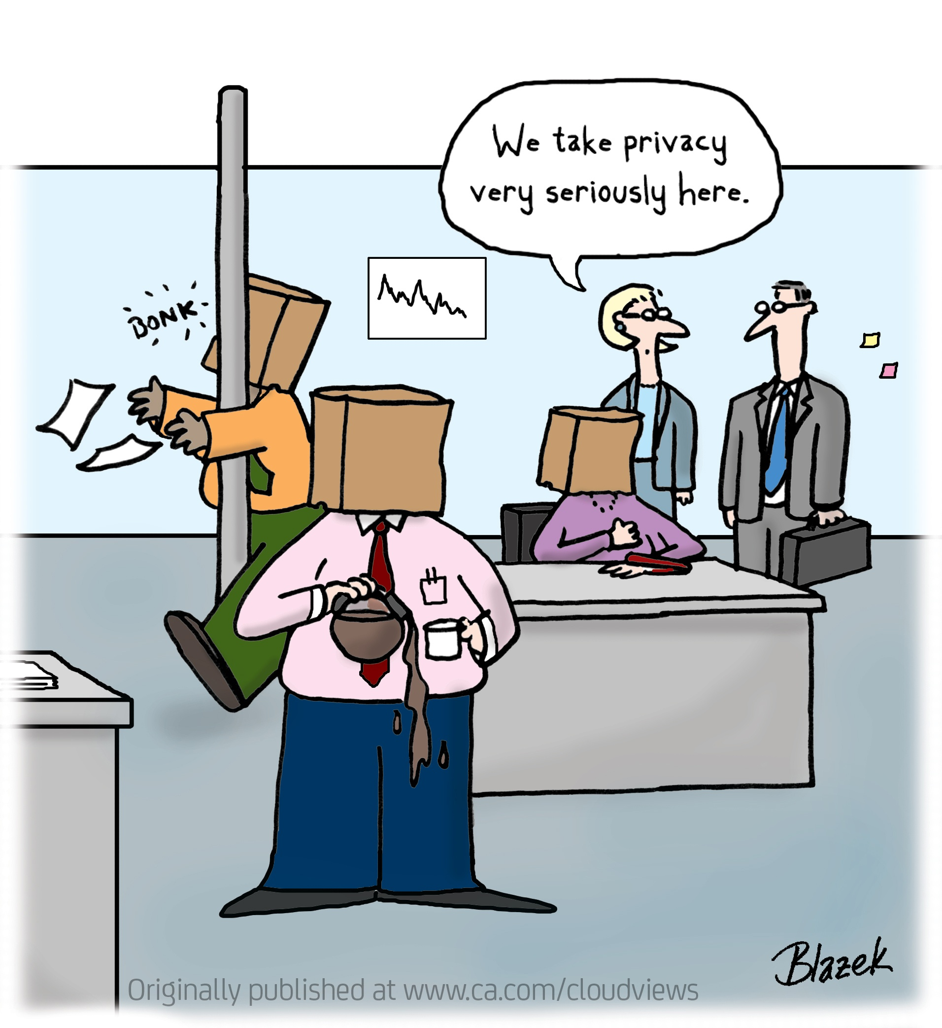
Cybersecurity Objectives / Obiectivele Securitaţii Informatice
Data confidentiality
only the sender and the intended receiver of should “understand” message contents
Authentication:
sender and receiver can confirm each other’s identity
Data Integrity:
Sender and receiver ensure the message was not altered (in transit or afterwards)
Data availability:
access and availability: services must be accessible and available to users
Privacy
Private life protection (GDPR)
Privacy: Europe is a step ahead with GDPR
Notes:
Data confidentiality – only the sender and the intended receiver of the data can “understand” the content
sender encrypts message
receiver decrypts message
Autenticitatea: expeditorul si destinatarul isi pot confirma unul altuia identitatea
Data Integrity: expeditorul si destinatarul se pot asigura ca mesajul nu a suferit alterare (in tranzit sau dupa), fara ca aceasta sa fie detectata.
Data availability: access and availability: services must be accessible and available to users
Privacy - protejarea vieţii private (GDPR)

Slide 7
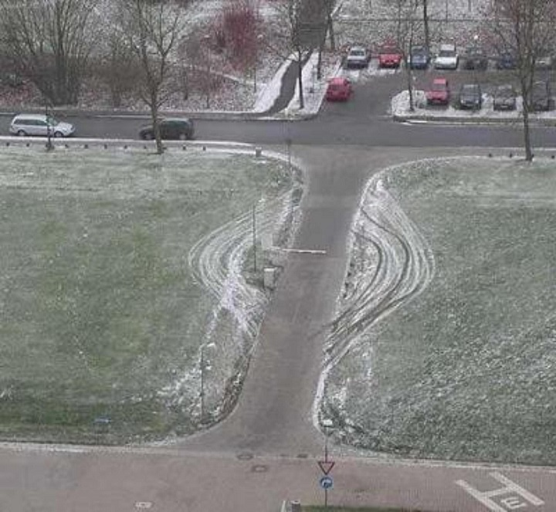
When Security Is Not Working

Slide 8

When Security Is Not Working
Weakest link principle in Security.
What is playing a role:
Technology
Humans
Anything else?
Notes:
Technology (security functions or features – encrypt data in transit and at rest)
Humans (end-users, tech-support staff, infrastructure admins – susceptibility to social engineering)
Laws
Anything else?

Slide 9



Communicarea securizată / Secure communication
Mesaje de email
Web browser/server
on-line banking client/server
DNS servers
Routers
Alte example?
Ana şi Bob doresc să comunice în secret
Un atacator poate intercepta, şterge, şi/sau adăuga mesaje
Canal de
comunicare
Ana
date, mesaje de control
Bob
date
Expeditor
Destinatar
date
Atacator
Notes:
Ana si Bob, cine pot fi ei:
Web browser/server for electronic transactions (e.g., on-line purchases)
on-line banking client/server
DNS servers
Routers exchanging routing table updates
Other examples?

Slide 10
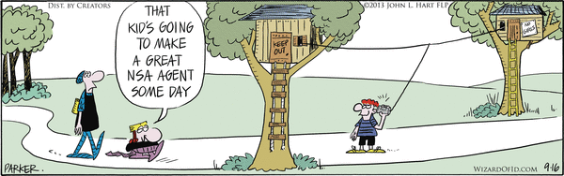
Man in the Middle Attacks
traficul poate fi interceptat
switch, ruter
atacuri de redirectare
un atacator poate investiga și modifica pachetele de rețea
un atacator poate impersona celălalt capăt al conversației

Slide 11
Cryptography Basics / Elemente de criptografie

Slide 12
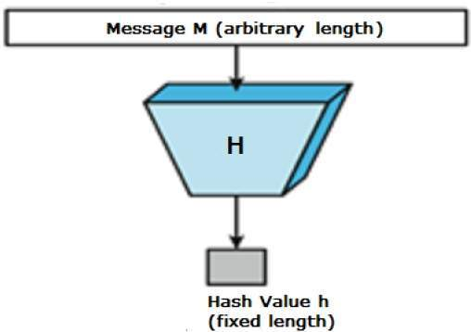
Cryptographic Hash Functions / Funcții hash criptografice
hash(value: array<byte>) → vector<byte, N> (for a given N)
Proprietatile unei functii hash criptografice
Determinista
Neinversabila
Rezistenta la coliziuni / collision resistant
H(input1) != H(input2) daca input1 != input2
Aplicatii:
GIT
Git log -> commit IDs – identificatori unici, calculati cu SHA1. De ce este important?
2. Distributii de produse software si mirrors copies (untrusted)
Notes:
SHA1 (bytes) -> 160 biti rezultat
Proprietati: greu de inversat.
>printf 'hello'
hello>printf 'hello' | sha1sum
aaf4c61ddcc5e8a2dabede0f3b482cd9aea9434d -
Dash-ul inseamna doar ca si-a luat input-ul de la stdin. Este un numar deterministic, daca incercati comanda pe calculatorul vostru, veti obtine acelasi rezultat.
Daca insa printf ‘Hello’ – obtineti acelasi rezultat
Note: while it may work for certain purposes, SHA-1 is no longer considered a strong cryptographic hash function. You might find this table of ilifetimes of cryptographic hash functions (https://valerieaurora.org/hash.html) nteresting. However, recommending specific hash functions is beyond the scope of this lecture. If you are doing work where this matters, you need formal training in security/cryptography.
C:\Monica\CodeSinaia-2022.src>git log
commit e7b79ef17b51b27b17abd2f7dcf07ff1a0c93533 (HEAD -> main, origin/main, origin/HEAD)

Slide 13
Hash function algorithms
MD5 hash function (obsolete)
computes 128-bit message digest in 4-step process.
SHA-1 is also obsolete
US standard [NIST, FIPS PUB 180-1]
160-bit message digest
SHA-2
Lifetimes of cryptographic hash functions: https://valerieaurora.org/hash.html

Slide 14
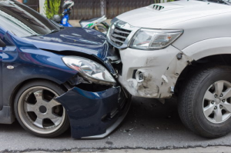
Practice: Hash collisions
The development team at ITRADE, an online trading platform, decided to write their Backend code (handling user's stocks) in Java.
A new user can offer his username (unless it is already taken).
There are no length restrictions and usernames are stored in DB by their hash value.
Java has a builtin hashing function (java/lang/String.hashCode()) => username.hashCode() is stored instead of the actual username.
When the user asks for selling X stocks, there is a check whether his username.hashCode() has X sellable stocks. If so, it is approved.
Mihai, a new MegaCorp employee, needs to pick his new ITRADE username. He knows that current MegaCorp stock value is one of the lowest in its history, and he also does not like Bob Ionescu, a veteran MegaCorp employee. Since Bob Ionescu thinks he is the Best Basketballer in the MegaCorp, he chose "BBBB" as it's username on ITRADE. In case Mihai knows Bob's username is "BBBB" - what can he do in order to sell Bob’s stocks?
Example code to print hashCode of Bob's username:
class Ideone { public static void main (String[] args) { String bobUsername = "BBBB"; System.out.println(bobUsername.hashCode() + "\n"); } }
Check https://ideone.com/GGAA8d
Notes:
Usernames are stored by their hash and a user can suggest its own username (unless it is already taken). Plus, looking at java/lang/String.hashCode() implementation, it is easy to observe that it is NOT a cryptographic hash function (https://en.wikipedia.org/wiki/Cryptographic_hash_function).
Meaning, it would be quite easy to find a hash collision (another username that would result in the same hash) to Bob's username, and ask for that username. Finding such a collision (in this case) can be done by simple math. After registering with one of those usernames, Mihai can ask to sell all of the stocks, so Bob will get the lowest price he could for those vested shares.
Visit https://ideone.com/GGAA8d to find some examples for username collisions.

Slide 15


Key Derivation Functions (KDS)/ Functii pentru derivarea cheilor
Proprietati: cele ale functiilor hash + se calculeaza incet
PBKDF2 = password-based key derivation function
Aplicatii:
Producere de chei din parole pentru criptarea simetrica
Stocarea informatiilor de login KDF(password + salt)
Notes:
Un concept legat de functii hash criptografice sunt key derivation functions (KDFs). Acestea sunt folosite pentru un numar de aplicatii, incluzand producerea unui output de lungime fixa pentru a il folosi ca si CHEIE in alti algoritmi de criptare, De obicei, calculul KDFs este incet in mod deliberat, pentru a face mai dificile / slow down offline brute-force attacks.
PBKDF2 = password based key derivation function
Applications
Producing keys from passphrases for use in other cryptographic algorithms / producerea cheilor din passphrases pentru folosire in alti algoritmi criptografici (e.g. symmetric cryptography).
Storing login credentials: a stoca parolele in clar nu este o practica buna. Cel mai correct este sa generam si sa stocam un SALT aleator pentru fiecare utilizator si apoi sa stocam KDF(password + salt). Verificarea loginului se face prin re-calcularea KDF data fiind parola introdusa de utilizator si sarea/SALT stocata.

Slide 16
Data confidentiality: criptarea mesajelor
Cheia de criptare a Anei
Cheia de decriptare a lui Bob
K
A
K
B
Mesaj in clar
(plaintext)
encryption
algorithm
Mesaj criptat
(ciphertext)
decryption
algorithm
Mesaj decriptat
(plaintext)
m: mesaj in clar
K_{A}(m): mesaj criptat cu cheia K_{A}
m = K_{B}(K_{A}(m))

Slide 17
Symmetric key cryptography
K
K
S
S
plaintext
encryption
algorithm
ciphertext
decryption
algorithm
plaintext
K (m)
S
symmetric key crypto: Bob and Ana share the same key: K
Q: how do Bob and Ana agree on the symmetric key value?
Notes:
Sharing same key: e.g., key is knowing substitution pattern in mono alphabetic substitution cipher

Slide 18
Symmetric Encryption / Criptarea simetrica
keygen() -> key
encrypt(plaintext: array<byte>, key) -> array<byte> (ciphertext)
decrypt(ciphertext: array<byte>, key) -> array<byte> (plaintext)
Proprietati:
Nu pot deduce plaintext din ciphertext, fara cheie
decrypt(encrypt(m, k), k) = m.
Notes:
Ascunderea continutului unui mesaj este probabil prima aplicatie care va vine in minte atunci cand va ganditi la criptografie. Criptarea simetrica realizeaza acest lucru cu urmatoarele functii:
keygen() -> key (aceasta functie include si elemente aleatoare/randomized)
encrypt(plaintext: array<byte>, key) -> array<byte> (the ciphertext)
decrypt(ciphertext: array<byte>, key) -> array<byte> (the plaintext)
Functia encrypt are proprietatea ca pentru un output dat (ciphertext), este greu sa se determine input (plaintext) fara cheie.
Functia decrypt are evidenta proprietate de corectitudine, ca decrypt(encrypt(m, k), k) = m.
Un examplu de cryptosystem simetric folosit pe scara larga astazi este AES.

Slide 19
Practice: openssl help
Install OpenSSL pt Windows: https://tecadmin.net/install-openssl-on-windows
Standard commands
asn1parse ca ciphers cms
crl crl2pkcs7 dgst dhparam
dsa dsaparam ec ecparam
enc engine errstr gendsa
genpkey genrsa help list
nseq ocsp passwd pkcs12
pkcs7 pkcs8 pkey pkeyparam
pkeyutl prime rand rehash
req rsa rsautl s_client
s_server s_time sess_id smime
speed spkac srp storeutl
ts verify version x509
Message Digest commands (see the `dgst' command for more details)
blake2b512 blake2s256 gost md4
md5 rmd160 sha1 sha224
sha256 sha3-224 sha3-256 sha3-384
sha3-512 sha384 sha512 sha512-224
sha512-256 shake128 shake256 sm3
Cipher commands (see the `enc' command for more details)
aes-128-cbc aes-128-ecb aes-192-cbc aes-192-ecb
aes-256-cbc aes-256-ecb aria-128-cbc aria-128-cfb
aria-128-cfb1 aria-128-cfb8 aria-128-ctr aria-128-ecb
aria-128-ofb aria-192-cbc aria-192-cfb aria-192-cfb1
aria-192-cfb8 aria-192-ctr aria-192-ecb aria-192-ofb
aria-256-cbc aria-256-cfb aria-256-cfb1 aria-256-cfb8
aria-256-ctr aria-256-ecb aria-256-ofb base64
bf bf-cbc bf-cfb bf-ecb
bf-ofb camellia-128-cbc camellia-128-ecb camellia-192-cbc
camellia-192-ecb camellia-256-cbc camellia-256-ecb cast
cast-cbc cast5-cbc cast5-cfb cast5-ecb
cast5-ofb des des-cbc des-cfb
des-ecb des-ede des-ede-cbc des-ede-cfb
des-ede-ofb des-ede3 des-ede3-cbc des-ede3-cfb
des-ede3-ofb des-ofb des3 desx
rc2 rc2-40-cbc rc2-64-cbc rc2-cbc
rc2-cfb rc2-ecb rc2-ofb rc4
rc4-40 seed seed-cbc seed-cfb
seed-ecb seed-ofb sm4-cbc sm4-cfb
sm4-ctr sm4-ecb sm4-ofb

Slide 20
Symmetric Encryption / Criptarea simetrica
Aplicatii:
securizare fisiere stocate in cloud (Dropbox, Google drive)
Passphrase → KDF → encrypt (text) → ciphertext
$ openssl aes-256-cbc -salt -in plain.txt -out newenc.out
$ openssl aes-256-cbc -d -in newenc.out -out newplain.txt
Notes:
Criptarea fisierelor stocate intr-un cloud/nor in care nu avem incredere (storage in an untrusted cloud service).
Aceasta poate fi combinate cu un Key Derivation Function, KDFs, astfel ca sa puteti cripta fisierul cu o parola . Generate key = KDF(passphrase), and then store encrypt(file, key).

Slide 21

Practice: Encrypt with AES-256
What is the salt?
$ openssl aes-256-cbc -salt -in plain.txt -out newenc.out
$ openssl aes-256-cbc -d -in newenc.out -out newplain.txt
enter aes-256-cbc decryption password:
*** WARNING : deprecated key derivation used.
Using -iter or -pbkdf2 would be better.
$ cat newenc.out
Salted__8ӑ`w8C?^:> cmp plain.txt newplain.txt
$ echo $?
0
$ cat newplain.txt
Hello world
$ cat newenc.out
Salted__8ӑ`w8C?^:>
Pentru protectie de atacuri bruteforce cu “rainbow tables” (tabele de hash-uri pentru cele mai populare parole)
se stocheaza [Salt, hash (pwd + salt)]
in loc de [hash (pwd)]
Notes:
monicae@MENEPIETSaaS:~$ openssl aes-256-cbc -salt -in plaintext.txt -out newencrypted.out
enter aes-256-cbc encryption password:
Verifying - enter aes-256-cbc encryption password:
*** WARNING : deprecated key derivation used.
Using -iter or -pbkdf2 would be better.
monicae@MENEPIETSaaS:~$ openssl aes-256-cbc -d -in newenc.out -out newplain.txt
enter aes-256-cbc decryption password:
*** WARNING : deprecated key derivation used.
Using -iter or -pbkdf2 would be better.
monicae@MENEPIETSaaS:~$ cat newenc.out
Salted__8ӑ`w8C?^:monicae@MENEPIETSaaS:~$ cmp plain.txt newplain.txt
monicae@MENEPIETSaaS:~$ echo $?
0
monicae@MENEPIETSaaS:~$ cat newplain.txt
Hello world

Slide 22
Practice: Where is the salt?
The code below verifies a password by comparing it to a stored hash value. There is a vulnerability in the system. Can you spot this vulnerability? How would you fix it?
1 2 3 4 5 6 7 8 9 | int VerifyAdmin(char *password) { if (strcmp(SHA1(password), password_SHA1)) { printf("Incorrect Password!\n"); return(0); } printf("Entering Diagnostic Mode...\n"); return(1); }
Real-life vulnerability in LinkedIn, resulting in information leakage and a $5m law suit: “… despite its contractual obligation to use best practices in storing user data, LinkedIn failed to utilize basic industry standard encryption methods. In particular, LinkedIn failed to adequately protect user data because it stored passwords in unsalted SHA1 hashed format.“ Read more
Notes:
Hash passwords are saved (and calculated) without salt meaning that the system is vulnerable to passwords rainbow tables. Refer to CWE-759: “Use of a One-Way Hash without a Salt”, to better understand the vulnerability.
A real life example of this vulnerability was in LinkedIn information leakage, which results a law suit:
"However, and despite its contractual obligation to use best practices in storing user data, LinkedIn failed to utilize basic industry standard encryption methods. In particular, LinkedIn failed to adequately protect user data because it stored passwords in unsalted SHA1 hashed format."
(read more)

Slide 23
Symmetric Encryption Algorithms
DES: Data Encryption Standard
US encryption standard [NIST 1993]
56-bit symmetric key
64-bit plaintext input
how secure is DES?
DES Challenge: 56-bit-key-encrypted phrase decrypted (brute force) in <1 day
making DES more secure:
3DES: encrypt 3 times with 3 different keys
AES: Advanced Encryption Standard
symmetric-key NIST standard
replaced DES (Nov 2001)
processes data in 128 bit blocks
128, 192, or 256 bit keys
brute force decryption (try each key) taking 1s for DES, takes 149 trillion years for AES
Notes:
The DES Challenges were a series of brute force attack contests created by RSA Security to highlight the lack of security provided by the Data Encryption Standard. 1997 - 1999.

Slide 24
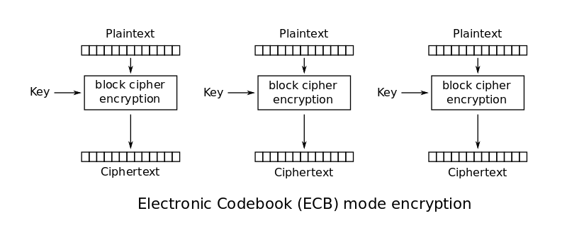
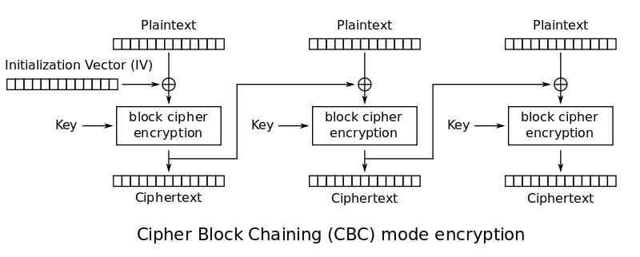
Symmetric Encryption / Criptarea simetrica
Based on either stream ciphers or block ciphers.
Stream ciphers:
each plaintext digit is encrypted one at a time with the corresponding digit of the keystream => a digit of the ciphertext stream. Example: OTP, RC4
Block ciphers operate on fixed-length blocks
Examples: Data Encryption Standard (DES) - deprecated, AES (Advanced Encryption Standard) supports block length of 128 bits and key lengths of 128, 192, and 256 bits.
Notes:
Example stream ciphers: one-time pad, RC4 (deprecated);
One Time Pad is a XOR between a message and a same-length secret
Bad news: If you want to encrypt N bits of data, you need a N-bit secret key

Slide 25

Asymmetric Encryption / Criptarea cu chei publice
symmetric key crypto:
requires sender, receiver know shared secret key
Q: how to agree on key in first place (particularly if never “met”)?
public key crypto
sender, receiver do not share secret key
public encryption key known to all
private decryption key known only to receiver
Public key cryptography revolutionized 2000-year-old cryptography!
Notes:
Asymmetric cryptography
Termenul “asymmetric” se refera la faptul ca exista doua chei cu doua roluri diferite.
O cheie private care, dupa cum si numele implica, este tinuta secreta,
In timp ce cheia public poate fi dezvaluita, facuta publica, fara ca securitatea sa fie afectata (spre deosebire de folosirea aceleiasi chei in sistemele de criptare simetrice)

Slide 26
Public Key Criptography: Functionalities
Generate key pair: keygen() -> (public key, private key)
Encrypt/Decrypt
encrypt(plaintext, public key) → ciphertext
decrypt(ciphertext, private key) → plaintext
Sign/Verify
sign(message, private key) → signature
verify(message, signature, public key) → bool (whether or not the signature is valid)
Notes:
Criptosistemele asimetrice furnizeaza urmatoarele functionalitati:
to encrypt/decrypt
to sign/verify
Functiile encrypt/decrypt au proprietati similar cu analoagele lor din sistemele de criptare simetrice. Un mesaj poate fi criptat folosind cheia publica. Dat fiind rezultatul (ciphertext), este dificil sa se determine inputul (plaintext) fara cheia privata. Functia decrypt are proprietatea de corectitudine evidenta, adica decrypt(encrypt(m, public key), private key) = m.

Slide 27
Public Key Cryptography
PUB _{B}
Bob’s public key
PRIV_{B}
Bob’s private key
plaintext
message, m
encryption
algorithm
ciphertext
decryption
algorithm
plaintext
PUB_{B}(m)
m = PRIV_{B}(PUB_{B}(m)
Cheia publica PUB_{B} se publica pe Internet … in locuri sigure!
Notes:
Criptarile simetrica si asimetrica pot fi comparate cu incuietorile fizice.
Un criptosistem simetric este ca incuietoarea unei usi: oricine are cheia poate sa o incuie si sa o descuie.
Criptarea asimetrica este ca o caseta cu cheie. Poti da caseta descuiata cuiva (cheia publica), ei pun mesajul in cuitie si apoi o incuie . Astfel doar tu o poti descioa pentru ca ai cheia de la caseta (cheia private).

Slide 28
Public Key Encryption Algorithms
requirements:
1
For a user A, we have PRIV_{A} and PUB_{A} such that
m = PRIV_{A} (PUB_{A} (m))
2
given the public key PUB_{A}, it should be impossible to compute the private key PRIV_{A}
RSA: Rivest, Shamir, Adleman algorithm

Slide 29
Public Key Encryption: Matematica
RSA (Rivest Shamir Adleman)
Se aleg doua numere prime mari p, q. (fiecare de 1024 biti / ~308 cifre)
Se calculeaza
n = p*q,
z = (p-1)(q-1)
Se alege e<n, relativ prim cu z.
Se alege d a.î. e*d mod z ≅ 1
Cheia publica PUB = (n,e)
Cheia privata PRIV = (n,d).
1. Pentru a cripta mesajul m (<n), se calculeaza c = m mod n
2. Pentru a decripta mesajul criptat, se calculeaza m = c mod n
m = (m ^{e} mod n) ^{d} mod n
c
Notes:
Exemplu: p=5, q=7. Then n=35, z=24
e=5 (so e, z relatively prime).
d=29 (so ed-1 exactly divisible by z).
encrypting 8-bit messages.
m = 00001000 = 12
m^e=24832
Encrypt: c=m^e mod n = 17
Decrypt c^d = 481968572106750915091411825223071697
c^d mod n = 12

Slide 30
Why does RSA work?
must show that c^{d} mod n = m, where c = m^{e} mod n
fact: for any x and y: x^{y} mod n = x^{(y mod z)} mod n
where n= pq and z = (p-1)(q-1)
thus, c^{d} mod n = (m^{e} mod n)^{d} mod n
= m^{ed} mod n
= m^{(ed mod z)} mod n
= m¹ mod n
= m

Slide 31
Important Property
PRIV_{U} (PUB_{U}(m)) = PUB_{U} (PRIV_{U}(m))
(m^{e} mod n)^{d} mod n = m^{ed} mod n
= m^{de} mod n
= (m^{d} mod n)^{e} mod n
The result is the same:
If the public key is used first, followed by private key
OR
if the private key is used first, followed by public key

Slide 32
RSA security
If you know Bob’s public key (n,e), how hard is it to determine d?
essentially need to find factors of n without knowing the two factors p and q
fact: factoring a big number is hard
In 2019, Fabrice Boudot, Pierrick Gaudry, Aurore Guillevic, Nadia Heninger, Emmanuel Thomé and Paul Zimmermann factored a 240-digit (795-bit) number utilizing approximately 900 core-years of computing power. The researchers estimated that a 1024-bit RSA modulus would take about 500 times as long.^{[3]}

Slide 33
Practice:
Playing with the RSA key pair
Generate an RSA private key, 2048 bit long modulus
Decode the key, display the value of n and the p, q primes
Pick a strong password and generate a new key, protected by this password and AES256:
Decode this new key, find out the values for the modulus and the exponent
https://github.com/DariusBuhai/FMI-Unibuc/tree/main/Year%20III/Semester%201/SSI/Laborator/Laborator%2010
Notes:
monicae@MENEPIETSaaS:~$ openssl pkeyutl -help
Usage: pkeyutl [options]
Valid options are:
-help Display this summary
-in infile Input file - default stdin
-out outfile Output file - default stdout
-pubin Input is a public key
-certin Input is a cert with a public key
-asn1parse asn1parse the output data
-hexdump Hex dump output
-sign Sign input data with private key
-verify Verify with public key
-verifyrecover Verify with public key, recover original data
-rev Reverse the order of the input buffer
-encrypt Encrypt input data with public key
-decrypt Decrypt input data with private key
-derive Derive shared secret
-kdf val Use KDF algorithm
-kdflen +int KDF algorithm output length
-sigfile infile Signature file (verify operation only)
-inkey val Input private key file
-peerkey val Peer key file used in key derivation
-passin val Input file pass phrase source
-peerform PEM|DER|ENGINE Peer key format - default PEM
-keyform PEM|DER|ENGINE Private key format - default PEM
-pkeyopt val Public key options as opt:value
-rand val Load the file(s) into the random number generator
-writerand outfile Write random data to the specified file
-engine val Use engine, possibly a hardware device
-engine_impl Also use engine given by -engine for crypto operations

Slide 34
Practice: Playing with the RSA key pair
Generate an RSA private key, 2048 bit long modulus
$ openssl genrsa -out ana_sk.pem 2048
Decode the key, display the value of n and the p, q primes:
$ openssl rsa -in ana_sk.pem –text $ cat ana_sk.pem
Pick a strong password and generate a new key, protected by this password and AES256:
$ openssl genrsa -aes256 -out ana_sk_protected.pem 2048
$ cat ana_sk_protected.pem
$ openssl rsa -in ana_sk_protected.pem -RSAPublicKey_out -out ana_pk.pem
Decode this new key, find out the values for the modulus the exponent:
$ openssl rsa -RSAPublicKey_in -in ana_pk.pem -text
https://github.com/DariusBuhai/FMI-Unibuc/tree/main/Year%20III/Semester%201/SSI/Laborator/Laborator%2010
Notes:
$ openssl pkeyutl -help

Slide 35
Session Keys
exponentiation in RSA is computationally intensive
DES is at least 100 times faster than RSA
use public key crypto to establish secure connection, then establish second key – symmetric session key – for encrypting data
session key, K_{S}
Bob and Ana use RSA to exchange a symmetric session key K_{S}
once both have K_{S}, they use symmetric key cryptography

Slide 36
Practice: Session Keys (WIP)
Encrypt the file bob_message.txt using RSA and the previously generated key
$ openssl pkeyutl -sign -in bob_message.txt -inkey ana_sk.pem -out encryptedBob.txt
If the file is too large, generate a 256 bit key (32 bytes) and encrypt with AES
$ openssl rand 32 > bob_symetric_key.key
$ openssl enc -aes256 -a -in bob_message.rtf -out bob_message_encrypted.rtf -kfile bob_symetric_key.key
Encrypt the AES key using asymmetric encryption, using RSA.
openssl pkeyutl -sign -in bob_symetric_key.key -inkey ana_sk.pem -out bob_symetric_key_encrypted.key
Decrypt and obtain the initial message
openssl enc -aes256 -d -in bob_message_encrypted.rtf -kfile bob_symetric_key.key

Slide 37





Aplicaţii / Applications
Email securizat / Secure email
Criptat si/sau semnat
cheia publica publicata online
PGP key
Semnarea pachetelor software (Windows DLLs, distributii Linux)
Semnarea in GIT
Private/Instant messaging:
Signal
WhatsApp
Telegraph
(Cheia publica este pe server)
> git log
> git tag
> git cat-file –p v1.3
> git tag –v v1.3

Slide 38
Authentication
Goal: Bob wants Ana to “prove” her identity to him
Ana says “I am Ana”
“I am Ana”
failure scenario??

Slide 39
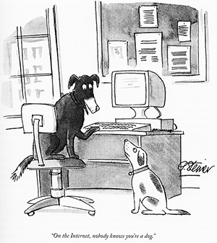
Authentication
Goal: Bob wants Ana to “prove” her identity to him
in a network, Bob can not “see” Ana, so an attacker simply declares himself to be Ana
“I am Ana”

Slide 40
Digital signatures
Bob receives msg m, with signature: m, PRIV_{A}(m)
Bob verifies m is signed by Ana by applying Ana’s public key PUB_{A} to m→ PUB_{A}(m) then checks PUB_{A}(PRIV_{A}(m) ) = m.
If PUB_{A}(PRIV_{A}(m) ) = m, whoever signed m must have used Ana’s private key
Bob thus verifies that:
Ana signed m
no one else signed m
Ana signed m and not m’
non-repudiation:
Bob can take m, and the signature PRIV_{B}(m) to court and prove that Ana signed m

Slide 41

Message digests
It is computationally expensive to encrypt long messages with public key
goal: fixed-length, easy-to-compute digital “fingerprint”
apply hash function H to m, get fixed size message digest, H(m)
large
message
m
H: Hash
Function
H(m)
Hash function properties:
many-to-1
produces fixed-size msg digest (fingerprint)
not-reversible: cannot determine m from H(m)
Notes:
Not-reversible given message digest x it is computationally infeasible to find m such that x = H(m)

Slide 42
Digital Signatures / Semnaturi Digitale
sender (Bob) digitally signs document: he is document owner/creator.
verifiable, nonforgeable: recipient (Ana) can prove to someone that Bob, and no one else, must have signed document
simple digital signature for message m:
Bob signs m by encrypting with his private key PRIV_{B}, creating “signed” message, PRIV_{B}(m)
PRIV_{B}
Bob’s message, m
Bob’s private
key
m, PRIV_{B}(m)
Dear Ana
Oh, how I have missed you. I think of you all the time! …(blah blah blah)
Bob
Dear Ana
Oh, how I have missed you. I think of you all the time! …(blah blah blah)
Bob
Public key
encryption
algorithm
PRIV_{B}(m)
Notes:
The sign/verify functions have the same properties that you would hope physical signatures would have, in that it’s hard to forge a signature. No matter the message, without the private key, it’s hard to produce a signature such that verify(message, signature, public key) returns true. And of course, the verify function has the obvious correctness property that verify(message, sign(message, private key), public key) = true.

Slide 43
Digital signature = signed message digest
Bob sends digitally signed message:
Ana verifies signature, integrity of digitally signed message:
large
message
m
H: Hash
Function
H(m)
encrypted
message digest
-
K_{B}(H(m))
digital
signature
(encrypt)
Bob’s
private
key
large
message
m
-
K
B
digital
signature
(decrypt)
Bob’s
public
key
+
encrypted
message digest
H: Hash
function
K
B
+
-
K_{B}(H(m))
H(m)
H(m)
?
equal

Slide 44
Practice: Authentication
The following Python code is part of a web application users management module. Explain how can one user impersonate another?
1 2 3 4 5 6 7 8 9 10 11 12 | def register(self, user, pw): if self.isExist(user): return False self.users = '%s:%s;%s' %(user, pw, self.users) return True def isExist(self, user): names = [e.split(':')[0] for e in self.users.split(';')] return user in names def login(self, user, pw): return ('%s:%s' %(user,pw)) in self.users.split(';')
Notes:
Ana can register the username: bob:123;Ana and then login to bob's account using the password: 123

Slide 45
Digital Certificates

Slide 46
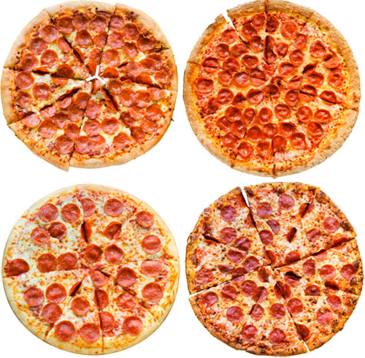
Need for certified public keys
Example: Trudy plays pizza prank on Bob
Trudy creates e-mail order: Dear Pizza Store, Please deliver to me four pepperoni pizzas. Thank you, Bob
Trudy signs order with her private key
Trudy sends order to Pizza Store
Trudy sends to Pizza Store her public key, but says it’s Bob’s public key
Pizza Store verifies signature; then delivers four pepperoni pizzas to Bob
Bob doesn’t even like pepperoni ☺
Notes:
Trudy: order + PRIV_{T}(order) + PUB_{T} => store
Store: checks signature PUB_{T} (PRIV_{T} (order)) = TRUE

Slide 47
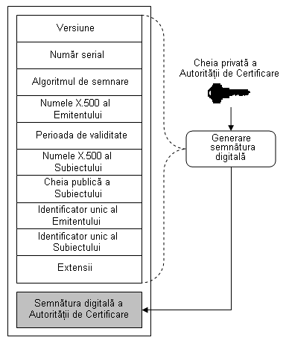
Digital certificates
X509.v3 format
Lanţ de certificare într-un model de încredere ierarhic
Practice (on Windows) run→ certmgr.msc

Slide 48
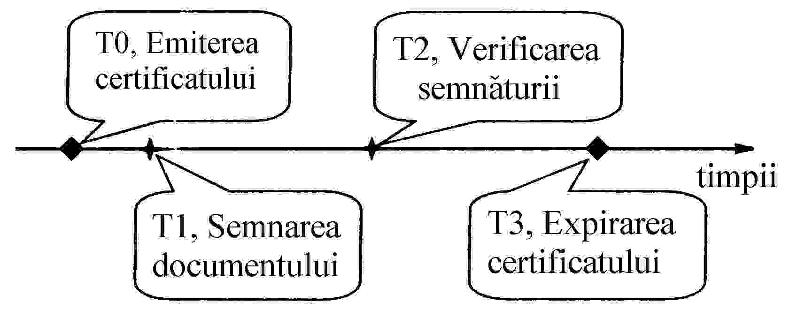
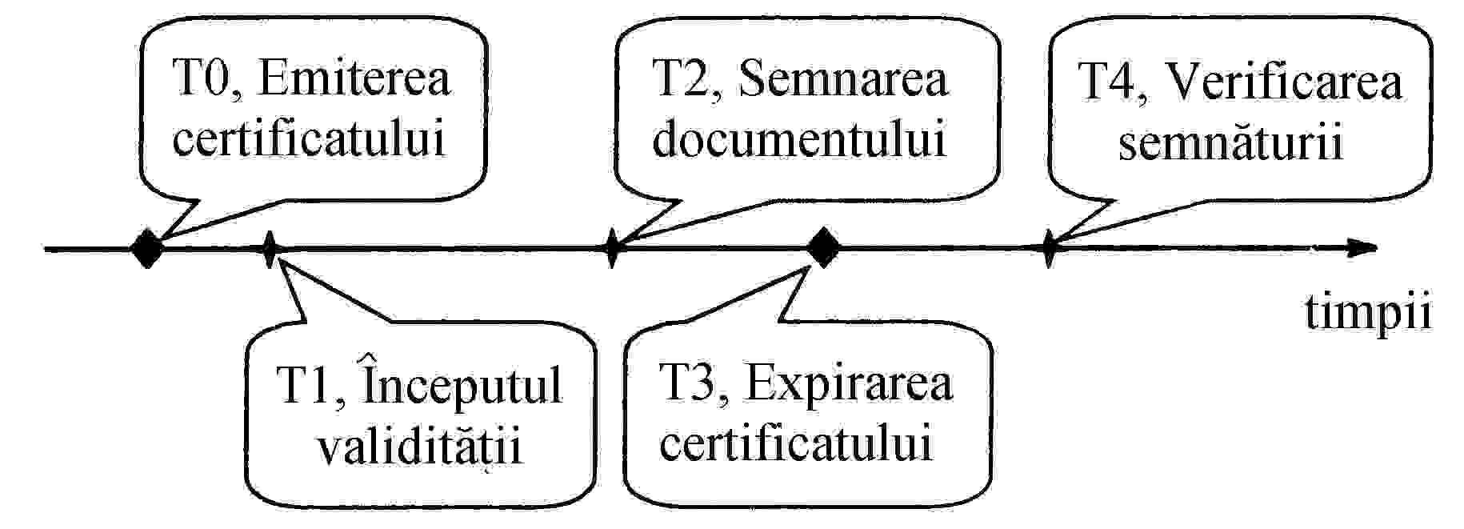
Digital Certificates Validation
When the certificate is valid
When the certificate is expired

Slide 49
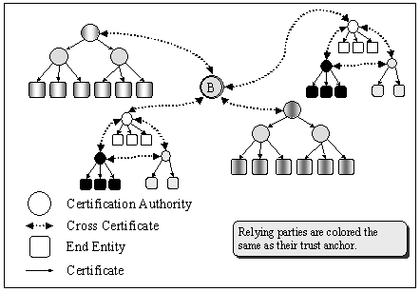
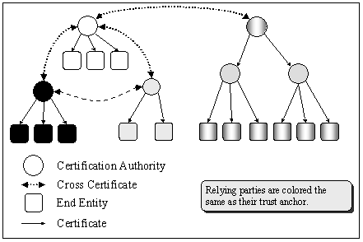
Digital Certificates at Global Scale
Certification between organizations and companies
Cross-certification between PKI domains
Bridge CA

Slide 50
Practice:
Generate your own digital certificate
Generate a (PUB, PRIV) key pair
Generale the digital certificate for the above PUB key using:
Valability = 365 days
Country = RO
State or Province Name = Prahova
Locality Name = Sinaia
Organization Name = InProTEd
Common Name = CA_YourTeamName
Email = YourTeamName@inproted.org
$ openssl genrsa -out domain.key 2048
$ openssl req –key domain.key –new -out mycertificate.csr
$ openssl x509 -signkey domain.key -in domain.csr -req -days 365 -out domain.crt
$ openssl req -newkey rsa:2048 -keyout domain.key -x509 -days 365 -out mycertificate.crt
Notes:
openssl req -key domain.key -new -out domain.csr
openssl x509 -signkey domain.key -in domain.csr -req -days 365 -out domain.crt
___________
openssl req -newkey rsa:2048 -keyout domain.key -x509 -days 365 -out domain.crt

Slide 51
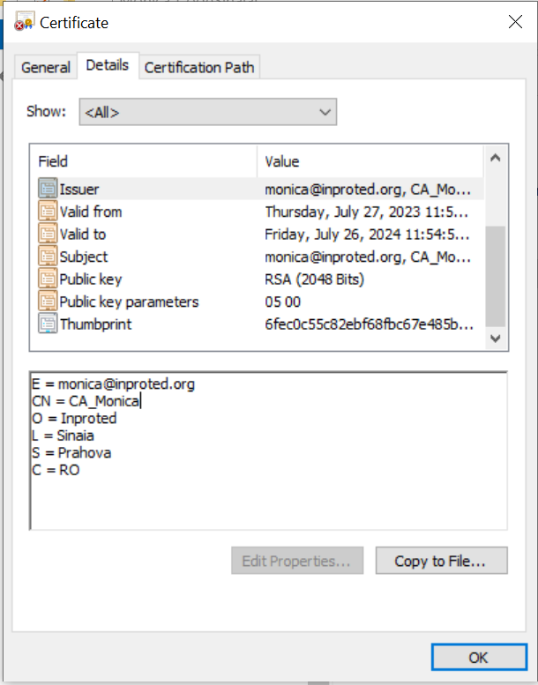
View the certificate
openssl x509 -text -noout -in domain.crt
Certificate:
Data:
Version: 1 (0x0)
Serial Number:
14:6b:90:d3:e6:2f:39:d9:bf:95:94:4e:01:eb:30:7c:cd:a5:0d:75
Signature Algorithm: sha256WithRSAEncryption
Issuer: C = RO, ST = Prahova, L = Sinaia, O = Inproted, CN = CA_Monica, emailAddress = monica@inproted.org
Validity
Not Before: Jul 27 20:54:58 2023 GMT
Not After : Jul 26 20:54:58 2024 GMT
Subject: C = RO, ST = Prahova, L = Sinaia, O = Inproted, CN = CA_Monica, emailAddress = monica@inproted.org
Subject Public Key Info:
Public Key Algorithm: rsaEncryption
RSA Public-Key: (2048 bit)
Modulus:
[…]
Exponent: 65537 (0x10001)
Signature Algorithm: sha256WithRSAEncryption
5f:37:47:02:6a:35:72:f0:b5:65:3a:5d:c9:20:45:86:73:eb:
[…]

Slide 52
Proiect final
1. Generati o pereche de chei publica/privata: cheia publica intr-un certificat digital auto-semnat sau emis de o autoritate de certificare
2. Semnati un fisier
Cititi continut fisier in clar
Calculati hash fisier folosind SHA256
Criptati SHA256 hash folosind cheia privata => semnatura digitala
Verificati semnatura digitala folosind cheia publica corespunzatoare
3. Criptati continutul unui fisier
Cititi continut fisier in clar
Generati o cheie simetrica AES (256)
Criptati text din fisier => text criptat
Criptati cheia AES256 folosind cheia publica
Decriptati cheia folosind cheia privata corespunzatoare

Slide 53
Backup slides

Slide 54
More resources
MIT course on computer systems security (6.858)
MIT course on cryptography (6.857 and 6.875)
Growth of Cryptography https://courses.csail.mit.edu/6.857/2020/files/L02-Killian-lecture-slides-on-growth-of-cryptography.pdf
If you want to roll your own crypto.

Slide 55
RSA example:
Bob chooses p=5, q=7. Then n=35, z=24.
e=5 (so e, z relatively prime).
d=29 (so ed-1 exactly divisible by z).
encrypting 8-bit messages.
m
e
e
bit pattern
m
c = m mod n
encrypt:
0000l000
12
24832
17
d
d
c
c
m = c mod n
decrypt:
17
481968572106750915091411825223071697
12

Slide 56
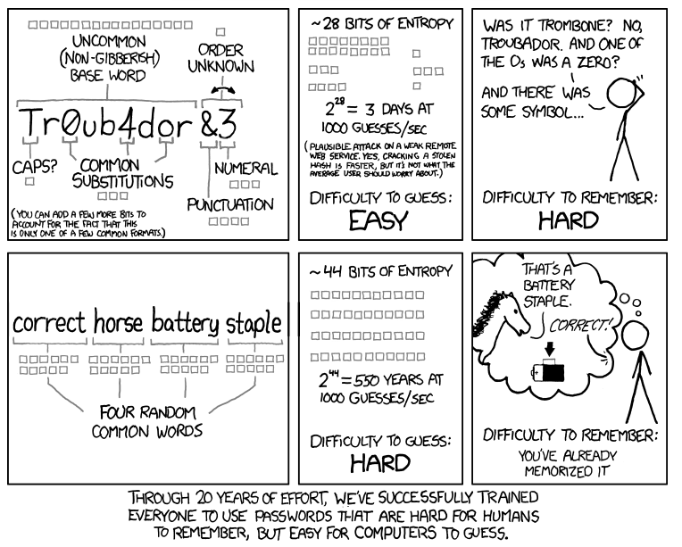
Securitatea parolelor
Entropia determină cat de aleatoare sunt datele
Cate de puternica este o parola?
Rezistenta la:
Brute force attacks
Dictionary attacks
Cantitatea de entropie: masurata in biti
log₂(numar_de_posibilitati)
Notes:
Dupa cum ilustreaza si aceasta caricatura / XKCD comic , o parola ca “correcthorsebatterystaple” este mai sigura decat “Tr0ub4dor&3”. Dar cum cuantificam cantitatea de Securitate pentru asa ceva ? Entropia este masurata in bits, si cand selectam uniform aleator dintr-un set de outcomes, entropia este egala cu log_2(# of possibilities). Daca ai 1000 de posibilitati si ghicesti 1000 posibilitati / secunda, nu este o Securitate foarte buna.
Sa luam cateva exemple:
Aruncarea unei monede (coin flip) are doua posibilitati => log2 (2)=1 are 1 bit de entropie.
Aruncarea unui zar (zarul are 6-fete) are log2 (6) = ~2.58 biti de entropie.
Asa cuantificam entropia.
Revenim la XKCD comic, prima parola are 28 biti de entropie iar a doua are 44biti. Se pot ghici 1000parole/secunda.
Tineti cont de faptul ca atacatorii cunosc modelul parolei, dar nu si gradul de randomness (e.g. from dice rolls) folosit pentru selectarea unei anumite parole.
Cati biti de entropie sunt destui? Depinde de modelul de securitate. Pentru online guessing, as the XKCD comic points out, ~40 bits of entropy is pretty good. To be resistant to offline guessing, a stronger password would be necessary (e.g. 80 bits, or more).
Oamenii nu sunt buni sa aleaga numere aleatoare. Daca v-as cere sa alegeti un numar intre 1 si 100, posibilitatea este ca nu va fi atat de aleator. Deci entropia este primul concept pe care il acoperim astazi. Aveti intrebari?

Slide 57
SSL / TLS
https://techcommunity.microsoft.com/t5/azure-sql-blog/the-importance-of-tls-with-sql-server/ba-p/3801220#M1415
TLS provide three security services, with an optional fourth.
The first is server authentication, in other words, “is the server I connect to the real server?”
The second is channel encryption.
The third is channel integrity protection.
The fourth option is client authentication, in other words, the server requires the client also authenticate themselves using TLS.
Now here is the critically important part:
Channel protections are of little use if you do not know which server you are talking to!
Do the right thing and use real certificates in dev/test that chain up to a trusted root. If you don’t want to use a commercial certificate authority (CA) you could use Windows Certificate Services and deploy the root certificate on your dev boxes.
This is precisely what I do in a Windows Server VM in Azure: I have my own CA and issue certs as needed, and when it’s not in use I just shut the VM down.

Slide 58
Challenge: Criptografia cu chei publice – atac cu numere prime
The widespread RSA cryptosystem is based on the difficulty of factoring large numbers into their prime constituents. Part of an RSA key is a large number (say N) which is the product of two prime numbers (say P and Q) that are randomly chosen and must never be revealed.
Assume that due to a faulty randomization process, the chance for different keys to contain identical prime factors has increased significantly. In other words, there is a good chance that for the numbers N1=P1*Q1 and N2=P2*Q2, it holds that P1=P2. Given the above assumption, explain how an adversary that knows N1, N2 but does not know P1, P2, Q1, Q2 is able to reveal them all.
Hint: Known for
Euclidean geometry
Euclid's Elements
Euclidean algorithm
Solution: Armed with a priori knowledge that N1 and N2 share a prime, all an attacker has to do in order to discover the value of that prime is to compute their greatest common denominator -- assuming that Q1 != Q2, we have P1=P2=GCD(N1,N2). The greatest common denominator is easily computed using Euclid's algorithm. Once P1=P2 is known, extracting Q1=N1/P1 and Q2=N2/P2 is trivial

